Slide 1

18CSC202J - OBJECT ORIENTED DESIGN AND PROGRAMMING
Session 11
Topic : Dynamic Modelling: Package Diagram, UML Component Diagram

Slide 2
Dynamic Modelling
The dynamic model is used to express and model the behaviour of the system over time. It includes support for activity diagrams, state diagrams, sequence diagrams and extensions including business process modelling.

Slide 3
Package Diagram
All the interrelated classes and interfaces of the system when grouped together form a package.
To represent all these interrelated classes and interface UML provides package diagram.
Package diagram helps in representing the various packages of a software system and the dependencies between them.
It also gives a high-level impression of use case and class diagram.

Slide 4
Package Diagram: purpose
To provide static models of modules, their parts and their relationships
To present the architectural modelling of the system
To group any UML elements
To specify the logical distribution of classes
To emphasize the logical structure of the system
To offer the logical distribution of classes which is inferred from the logical architecture of the system

Slide 5
Package Diagram: Uses
To illustrate the functionality of a software system.
To illustrate the layered architecture of a software system.
The dependencies between these packages can be adorned with labels / stereotypes to indicate the communication mechanism between the layers.

Slide 6
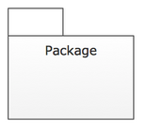
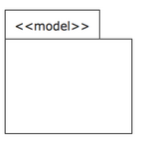
Notations
S.NO | NAME | SYMBOL | DESCRIPTION
1 | Package |  | organize elements into groups to provide better structure for system model.
2 | Mode |  | show only a subset of the contained elements according to some criterion.

Slide 7
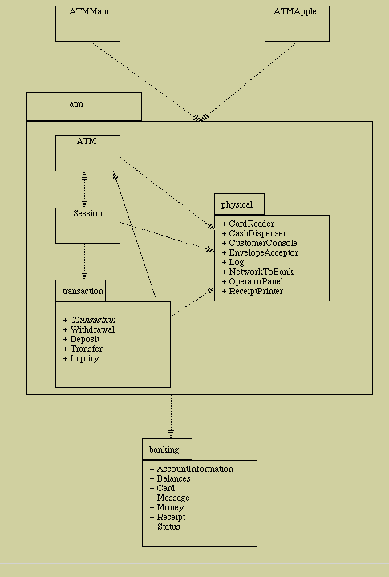
Example

Slide 8
Component Diagram
A component diagram shows the physical view of the system
A component is an autonomous unit within a system.
We combine packages or individual entities to form components.
We can depict various components and their dependencies using a component diagram.
Component diagram contain: component package, components, interfaces and dependency relationship.

Slide 9
Component Diagram: Purpose
It shows the structural relationship between the components of a system.
It identifies the architectural perspective of the system as they enable the designer to model the high level software components with their interfaces to other components.
It helps to organize source code into manageable chunks called components.
It helps to specify a physical database.
It can be easily developed by architects and programmers.
It enables to model the high level software components and the interfaces to those components.
The components and subsystem can be flexibly reused and replaced.

Slide 10
Guidelines to Draw
Based on the analysis of the problem description of the system, identify the major subsystem.
Group the individual packages and other logical entities in the system to provide as separate components.
Then identify the interfaces needed for components interaction.
If needed, identify the subprograms which are part of each of the components and draw them along with their associated components.
Use appropriate notations to draw the complete component diagram.

